Slide 1
Question 3
Cleaning, PCA & Clustering of a High-Dimensional Spectroscopic Dataset
SIMC 2026 Endeavour Challenge · Parts (a)–(h)
1000 vials of fermented drinks, each an infrared spectrum over 3401 frequencies — the labels are lost. We use linear algebra to clean the data, compress it, and recover how many distinct drinks were tested.
Clean (a) → Variance & PCA (b, c) → Leading direction (d) → Cluster two ways (e, f, g) → Count (h)
Result: 40 blanks + 36 anomalies handled · data is strongly low-dimensional (λ₁/λ₂≈3.5, elbow at 8) · 26 unique food samples

Slide 2
Part (a) — Remove the corrupted vials
2 points
▸ Method: reduce each spectrum to one number, its row-norm ‖x‖ (real peaks → large; empty vial → tiny).
▸ Empty vials: 40 sit far below a clean gap; threshold = the middle of the largest gap (robust, no arbitrary cutoff).
▸ Validation: empties are 50.2% exact zeros vs 24.5% for real spectra — a detector-clipping fingerprint confirms the split.
▸ The other error: 36 high-norm outliers at ‖x‖≈8.9, detached from the bulk — removed reversibly (could be a genuine strong drink).
▸ Result: cleaned design matrix with Ñ = 924 vials.
SIMC 2026 · Endeavour Challenge · Question 3
2

Slide 3
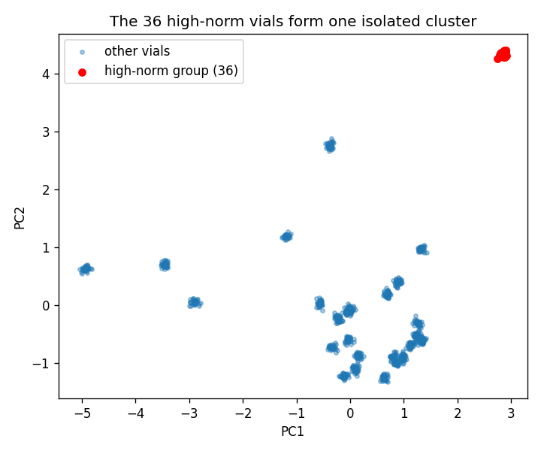
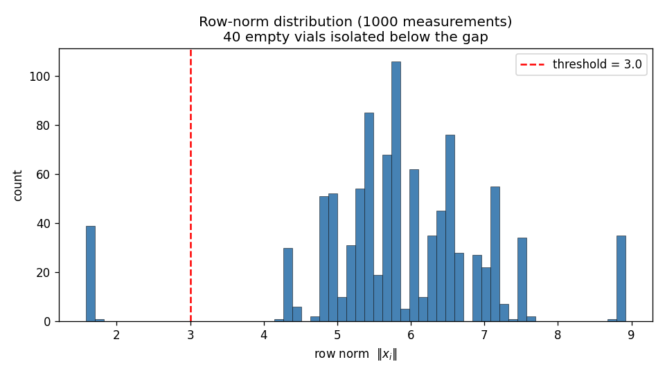
Part (a) — A clean gap isolates the bad vials
Figure
40 empty vials sit below the threshold (left); the 36 high-norm vials form one tight, isolated cluster (right).
SIMC 2026 · Endeavour Challenge · Question 3
3

Slide 4
Part (b) — Variance & the covariance matrix
3 points
▸ Setup: mean-center, then form the covariance C = (1/N) X̃ᵀX̃; its diagonal Cⱼⱼ is each feature's variance.
▸ Largest-variance feature: j* = 910, variance ≈ 0.0199. Total variance tr(C) ≈ 7.90.
▸ Structure: variance concentrates in a few narrow molecular bands; most of the 3401 frequencies are flat.
  – → only a handful of frequencies carry information — the data is effectively low-dimensional.
SIMC 2026 · Endeavour Challenge · Question 3
4

Slide 5
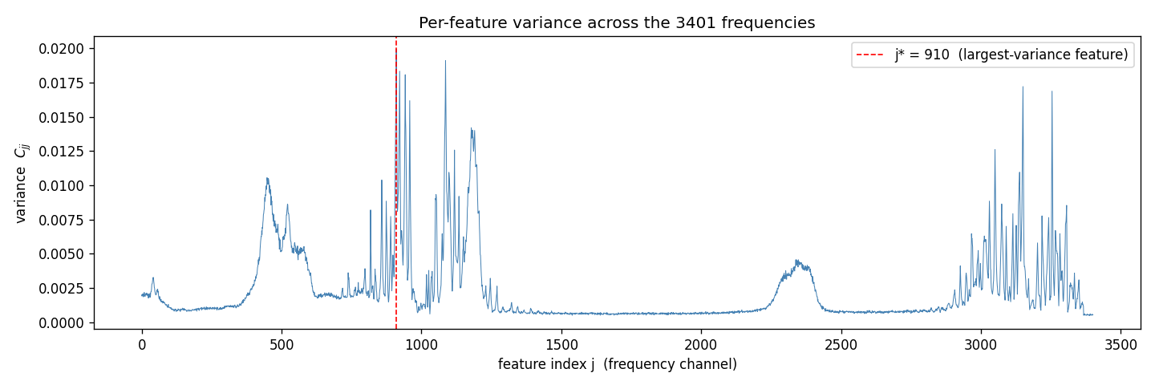
Part (b) — Variance lives in a few narrow bands
Figure
Per-feature variance spikes in a few molecular bands; the red line marks the maximal-variance feature j* = 910.
SIMC 2026 · Endeavour Challenge · Question 3
5

Slide 6
Part (c) — The eigenspectrum (PCA)
4 points
▸ PCA: eigendecomposition of C (via eigh — symmetric, stable, guaranteed real eigenvalues).
▸ Dominance ratio: λ₁/λ₂ ≈ 3.53 → one strong principal axis (a wide spectral gap).
▸ Elbow k* = 8: the largest multiplicative drop is λ₈/λ₉ ≈ 4.1 (use the ratio on a log scale, not the difference).
▸ Large ratio ⇒ low intrinsic dimension: signal lives in ~8 of 3401 dimensions (echoes the ~10 dominant molecules).
▸ Caution: the “95% variance” rule needs 667 components here — the elbow is the honest measure of dimensionality.
SIMC 2026 · Endeavour Challenge · Question 3
6

Slide 7
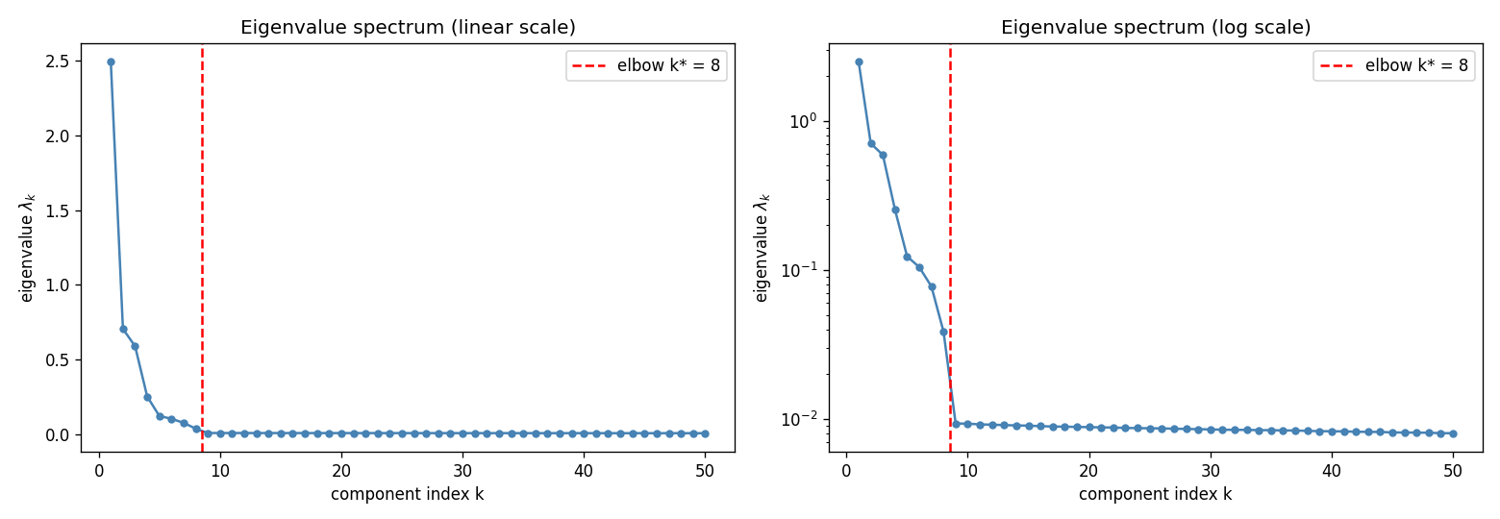
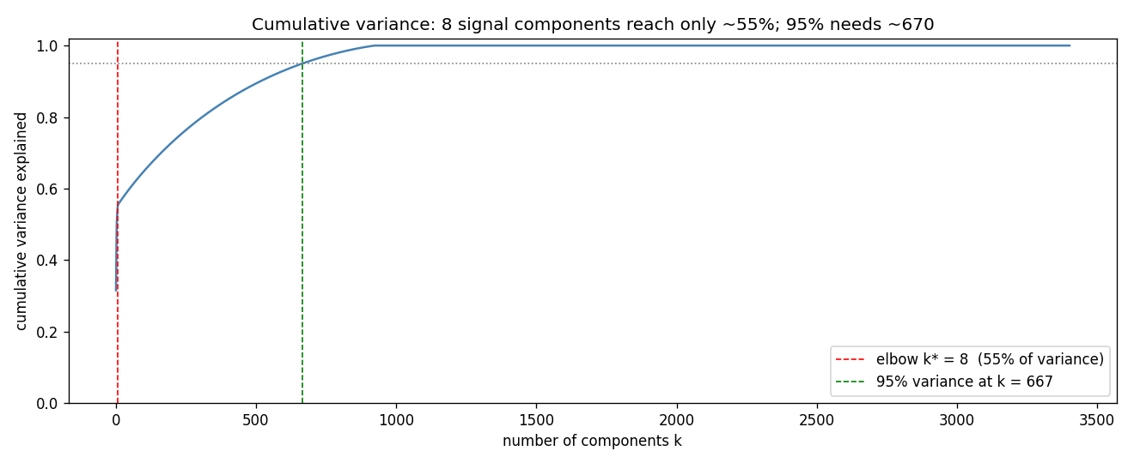
Part (c) — A sharp elbow at k* = 8
Figures
Eigenvalue spectrum (top): a sharp elbow at k*=8 on the log scale. Cumulative variance (bottom): 95% needs 667 components.
SIMC 2026 · Endeavour Challenge · Question 3
7

Slide 8
Part (d) — Interpreting the leading eigenvector
4 points
▸ ν₁ in feature space: a loading on each frequency; the score z = X̃ν₁ is the most informative one-number summary of a vial.
▸ Interpretation: concentrated on two narrow bands (j≈900–960 and 3150–3260) with mixed sign (~27% negative).
  – → a contrast direction: it splits vials by the balance of absorption between bands, not by overall brightness.
▸ Resemble a raw spectrum? cos≈0.92 vs a centered spectrum, but only 0.67 vs raw and 0.03 vs the mean.
  – → ν₁ is a difference-spectrum, a consequence of mean-centering (mirrors Q1's steady-state direction).
SIMC 2026 · Endeavour Challenge · Question 3
8

Slide 9
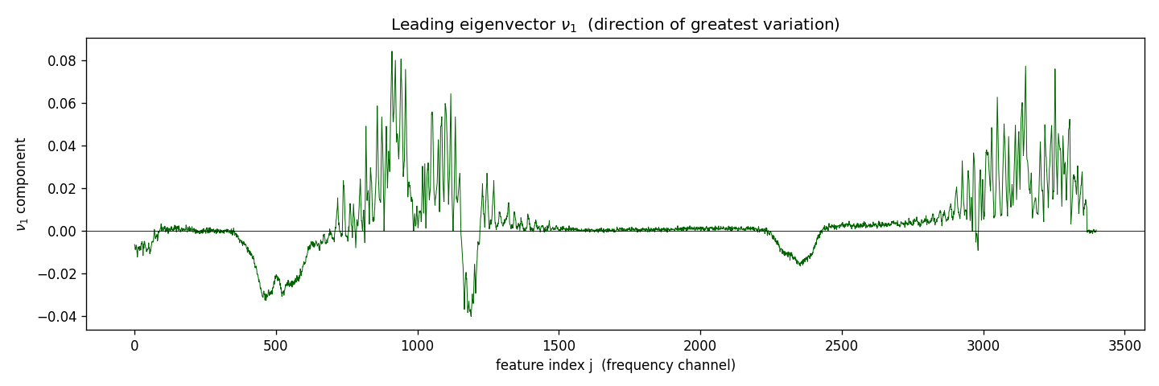
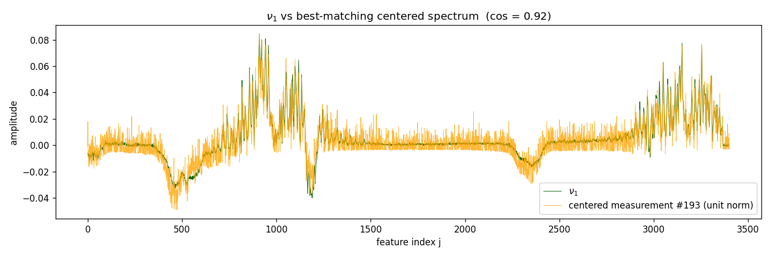
Part (d) — An interpretable contrast direction
Figure
ν₁ loadings concentrate on two molecular bands with mixed sign (top); ν₁ matches a centered spectrum at cos≈0.92, not a raw one (bottom).
SIMC 2026 · Endeavour Challenge · Question 3
9

Slide 10
Part (e) — Clusters via the covariance matrix
2 points
▸ Compress: project each vial onto the top-4 eigenvectors of C — Z = X̃ V₄ ∈ ℝ^(Ñ×4).
▸ Why four: inside the 8 signal directions, yet few enough to inspect as (4 choose 2) = 6 pairwise scatter plots.
▸ Picture: many tight, well-separated blobs — each is a set of vials with near-identical spectra (one concoction).
▸ Count: ≈ 25 clusters, stable across a wide range of radius → a property of the data, not of the threshold.
SIMC 2026 · Endeavour Challenge · Question 3
10

Slide 11
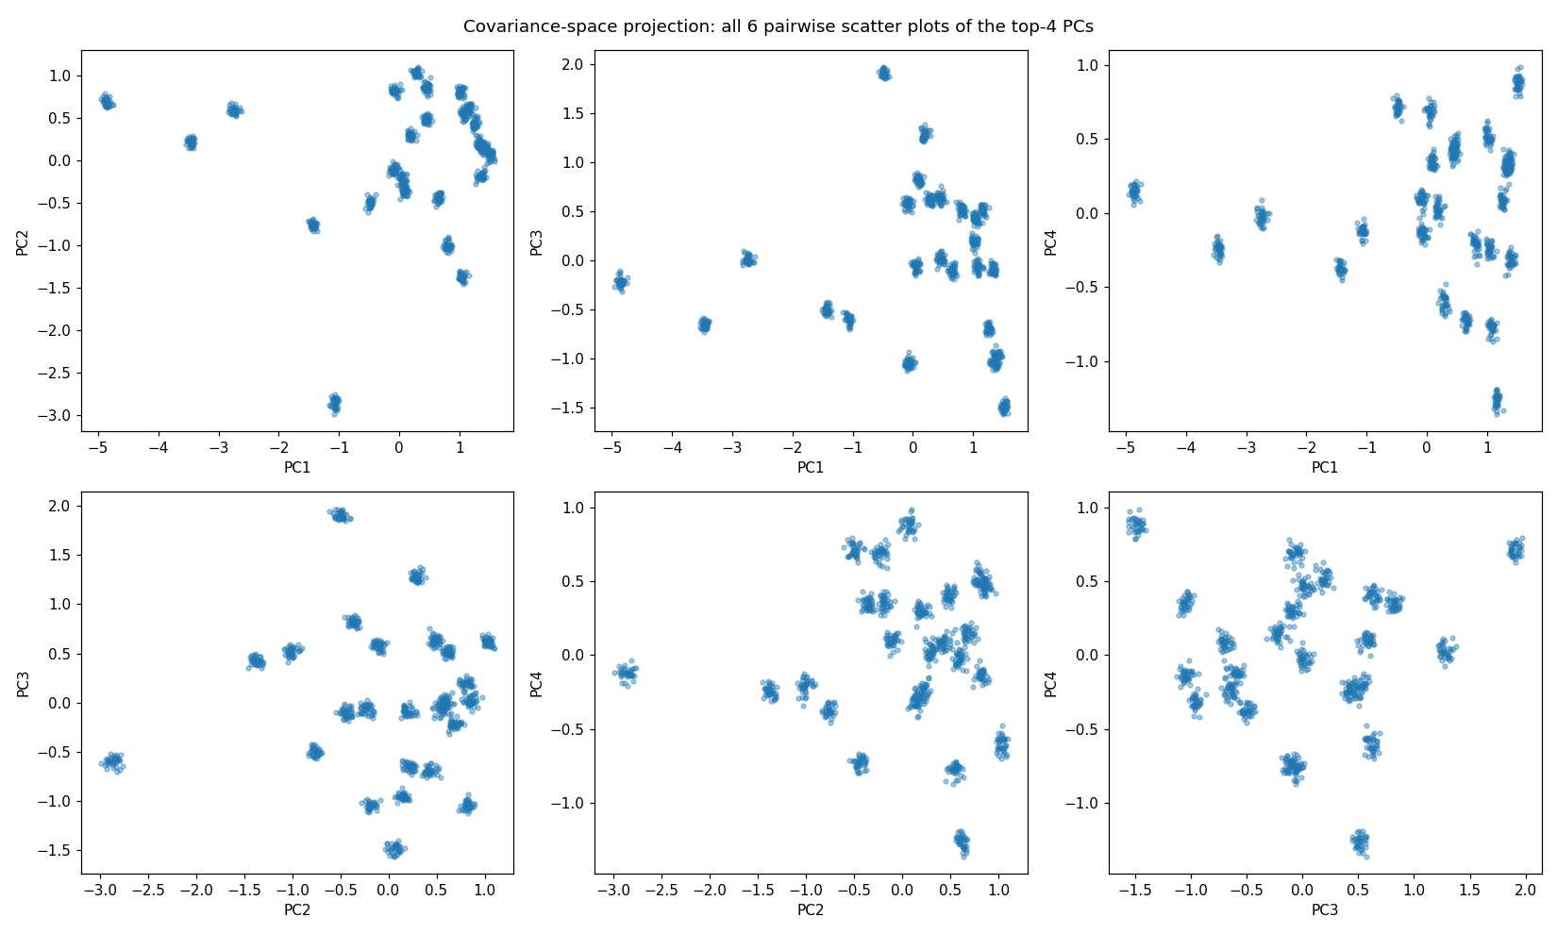
Part (e) — Clusters in covariance (feature) space
Figure
The 6 pairwise scatter plots of the top-4 covariance components: about 25 tight, well-separated clusters.
SIMC 2026 · Endeavour Challenge · Question 3
11

Slide 12
Part (f) — Clusters via the Gram matrix
4 points
▸ Gram matrix: G = (1/N) X̃ X̃ᵀ (Ñ×Ñ, sample space); Gᵢⱼ is the similarity between vials i and j.
▸ No projection needed: G's top-4 eigenvectors are already the sample coordinates (scale by √(Ñλ)=σ to match units).
▸ Same 6 scatters: they reproduce the covariance-space pictures up to per-axis sign flips.
▸ Count: 25 clusters again, stable over the same range of radius.
SIMC 2026 · Endeavour Challenge · Question 3
12

Slide 13
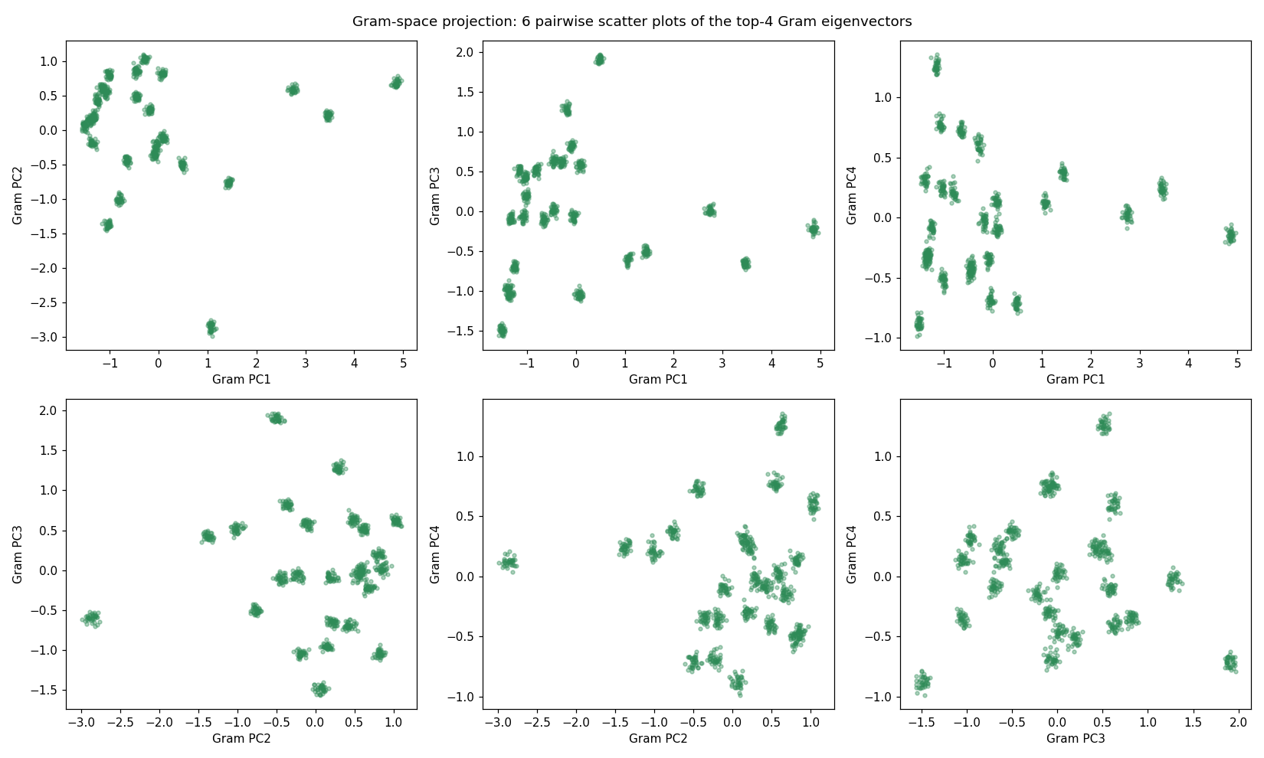
Part (f) — Clusters in Gram (sample) space
Figure
The same 6 scatter plots in Gram (sample) space: the same ~25 clusters, up to per-axis reflections.
SIMC 2026 · Endeavour Challenge · Question 3
13

Slide 14
Part (g) — Comparing the two approaches
3 points
▸ Same count — forced by algebra: if Cν=λν then X̃ν is an eigenvector of G with the same λ, so C and G share their nonzero eigenvalues.
  – With the SVD X̃ = UΣVᵀ, both coordinate sets equal UΣ up to a per-axis sign (matched comps |corr|=1, others ≈0).
▸ Covariance space asks: “which mixture of frequencies does this vial express?” (coords = projections onto feature patterns).
▸ Gram space asks: “which other vials does this one resemble?” (coords = a similarity fingerprint).
▸ Either way: near-identical spectra map to the same point → the two routes give the same clusters.
SIMC 2026 · Endeavour Challenge · Question 3
14

Slide 15
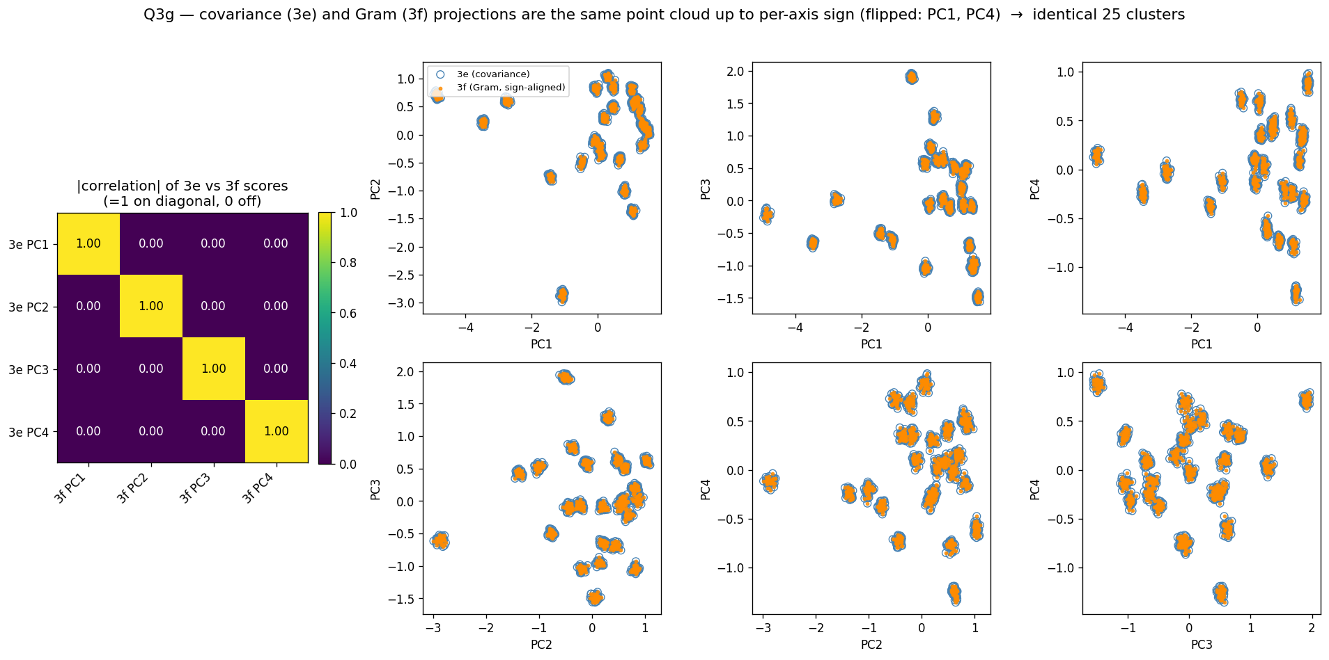
Part (g) — The two clusterings are identical
Figure
Matching components are perfectly correlated (|corr|=1) and distinct ones uncorrelated — the clusters coincide up to sign.
SIMC 2026 · Endeavour Challenge · Question 3
15

Slide 16
Part (h) — How many unique food samples?
6 points
▸ Cluster the genuine vials in the top-8 signal subspace (the elbow denoises the data so groups separate cleanly).
▸ 924-vial clustering → 25; restoring the 36 high-norm vials (a real strong concoction kept in part a) adds the 26th.
▸ Answer: 26 unique food samples, each measured ≈ 37 times (24×37 + 2×36 = 960).
  – Flat, equal-size groups are the fingerprint of a designed experiment (26 < 100, as the tester suspected).
▸ Parts that mattered: (a) cleaning removed a noise “cluster”; (c) the elbow let us cluster in denoised 8-D, not noisy 3401-D; (e–g) gave the count and proved it method-independent; (b, d) showed the data is low-dim with meaningful directions.
SIMC 2026 · Endeavour Challenge · Question 3
16

Slide 17
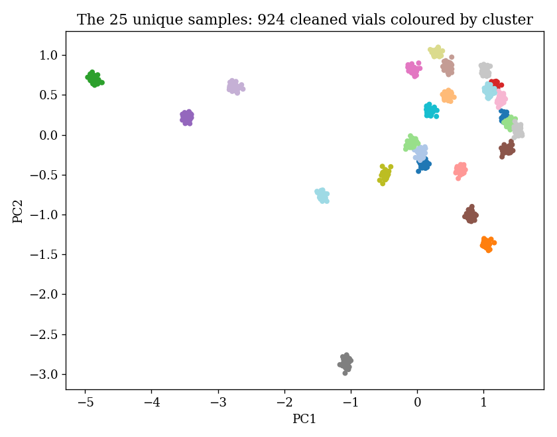
Part (h) — 26 distinct concoctions
Figure
924 genuine vials → 25 tight clusters (one concoction per colour); + the kept high-norm concoction = 26 unique samples.
SIMC 2026 · Endeavour Challenge · Question 3
17

